Slide 1
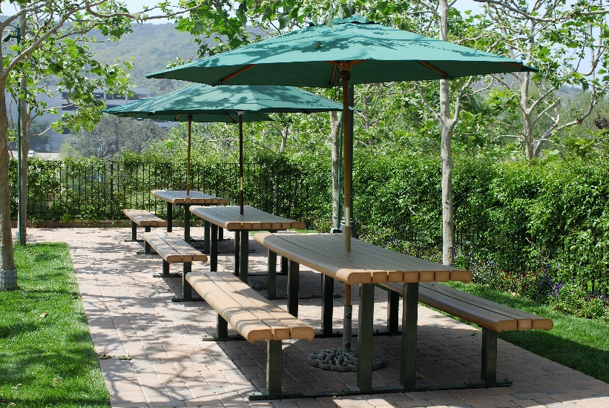
Tables
The <table> element
Table Borders
Nested Tables
List Styling

Slide 2

See Also
https://www.w3schools.com/html/html_tables.asp
https://www.youtube.com/watch?v=PetMdQBtW5U

Slide 3
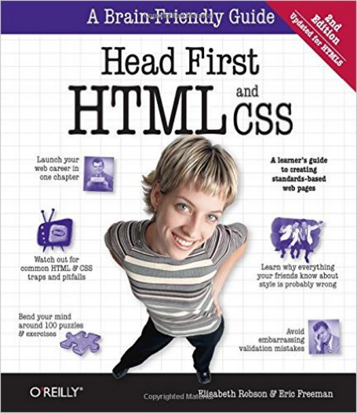
In the Book
Chapter 13:
Tables and More

Slide 4

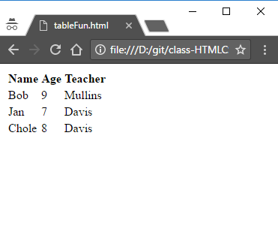
Rows and Cells
<table>
<tr>
<th>Name</th> <th>Age</th> <th>Teacher</th>
</tr>
<tr>
<td>Bob</td> <td>9</td> <td>Mullins</td>
</tr>
<tr>
<td>Jan</td> <td>7</td> <td>Davis</td>
</tr>
<tr>
<td>Chole</td> <td>8</td> <td>Davis</td>
</tr>
</table>

Slide 5
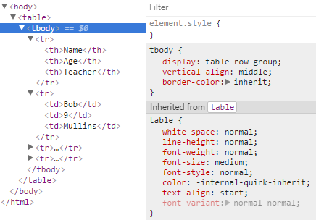
Header, Body, and Footer
<table>
<tbody>
<tr>
<th>Name</th> <th>Age</th> <th>Teacher</th>
</tr>
<tr>
<td>Bob</td> <td>9</td> <td>Mullins</td>
</tr>
<tr>
<td>Jan</td> <td>7</td> <td>Davis</td>
</tr>
<tr>
<td>Chole</td> <td>8</td> <td>Davis</td>
</tr>
</tbody>
</table>

Slide 6
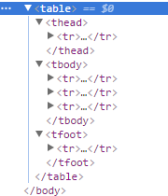
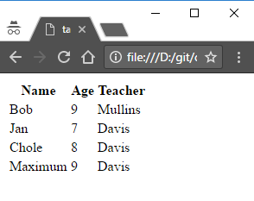
Header, Body, and Footer
<table>
<thead>
<tr>
<th>Name</th> <th>Age</th> <th>Teacher</th>
</tr>
</thead>
<tbody>
<tr>
<td>Bob</td> <td>9</td> <td>Mullins</td>
</tr>
<tr>
<td>Jan</td> <td>7</td> <td>Davis</td>
</tr>
<tr>
<td>Chole</td> <td>8</td> <td>Davis</td>
</tr>
</tbody>
<tfoot>...</tfoot>
</table>

Slide 7
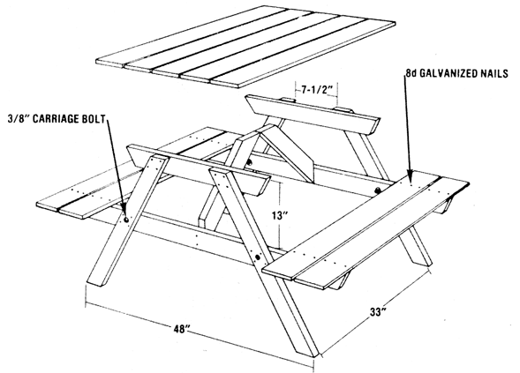
Header, Body, and Footer
These tags are mainly for you to use in CSS
Could be used by browsers for limited devices
Could be used by screen readers
Useful in your JavaScript to target content areas
Chrome will add a <tbody> with all the content

Slide 8
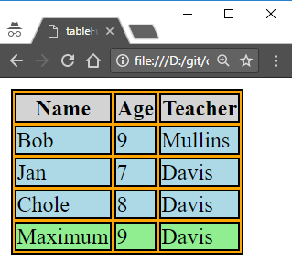
Table CSS
table, th, td, tr, tbody, thead, tfoot {
border: 1px solid black;
}
table {
background-color: orange;
}
thead {
background-color: lightgray;
}
tbody {
background-color: lightblue;
}
tfoot {
background-color: lightgreen;
}
Contribute color but not border

Slide 9
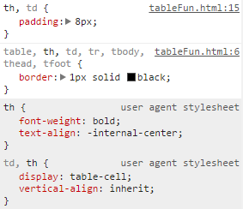
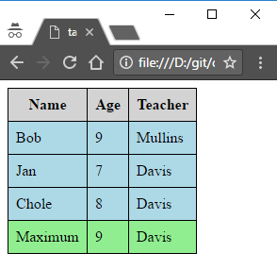
Collapsing
table, th, td {
border: 1px solid black;
}
table {
border-collapse: collapse;
}
th, td {
padding: 8px;
}

Slide 10
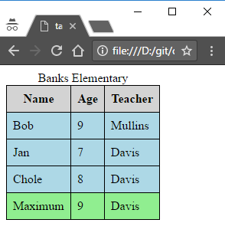
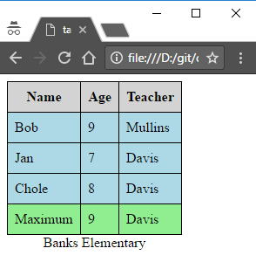
Caption
<table>
<caption>Banks Elementary</caption>
<thead> ... </thead>
<tbody> ... </tbody>
<tfoot> ... </tfoot>
</table>
table {
...
caption-side: bottom;
}

Slide 11
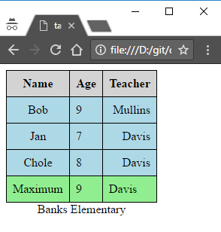
Text Alignment
<td class="Center">Bob</td> <td class="Left">9</td> <td class="Right">Mullins</td>
<td class="Center">Jan</td> <td class="Left">7</td> <td class="Right">Davis</td>
<td class="Center">Chole</td> <td class="Left">8</td> <td class="Right">Davis</td>
.Left {
text-align: left;
}
.Right {
text-align: right;
}
.Center {
text-align: center;
}

Slide 12
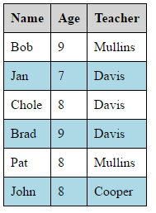
Row Striping
.odd {
background-color: white;
}
.even {
background-color: lightblue;
}
<tr>
<td class="Center odd">Bob</td> <td class="Left odd">9</td> <td class="Right odd">Mullins</td>
</tr>
<tr class="even">
<td class="Center">Jan</td> <td class="Left">7</td> <td class="Right">Davis</td>
</tr>
<tr class="odd">
<td class="Center">Chole</td> <td class="Left">8</td> <td class="Right">Davis</td>
</tr>
<tr class="even">
<td class="Center">Brad</td> <td class="Left">9</td> <td class="Right">Davis</td>
</tr>
<tr class="odd">
<td class="Center">Pat</td> <td class="Left">8</td> <td class="Right">Mullins</td>
</tr>
<tr class="even">
<td class="Center">John</td> <td class="Left">8</td> <td class="Right">Cooper</td>
</tr>

Slide 13
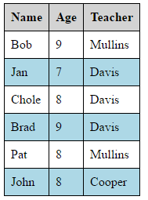
CSS nth-child
<tbody>
<tr>
<td>Bob</td> <td>9</td> <td>Mullins</td>
</tr>
<tr>
<td>Jan</td> <td>7</td> <td>Davis</td>
</tr>
<tr>
<td>Chole</td> <td>8</td> <td>Davis</td>
</tr>
<tr>
<td>Brad</td> <td>9</td> <td>Davis</td>
</tr>
<tr>
<td>Pat</td> <td>8</td> <td>Mullins</td>
</tr>
<tr>
<td>John</td> <td>8</td> <td>Cooper</td>
</tr>
</tbody>
Matches 6 things
tbody tr:nth-child(even) {
background-color: lightblue;
}
tbody tr:nth-child(odd) {
background-color: white;
}
1
2
3
4
5
6

Slide 14
CSS nth-child
n = 0, 1, 2, 3, …
tbody tr:nth-child(2n) {
background-color: lightblue;
}
tbody tr:nth-child(2n+1) {
background-color: white;
}
0, 2, 4, 6, …
n = 0, 1, 2, 3, …
1
1, 3, 5, 7, …
2
3
4
5
6

Slide 15
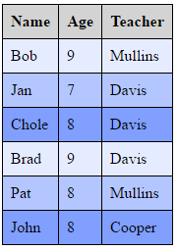
CSS nth-child
tbody tr:nth-child(3n) {
background-color: #809fff;
}
tbody tr:nth-child(3n+1) {
background-color: #e6ecff;
}
tbody tr:nth-child(3n+2) {
background-color: #b3c6ff;
}
n = 0, 1, 2, 3, …
0, 3, 6, 9, …
n = 0, 1, 2, 3, …
1, 4, 7, 10, …
n = 0, 1, 2, 3, …
1
2, 5, 8, 11, …
2
3
4
5
6

Slide 16

CSS nth-child
Not just for tables
Sequence of headers or paragraphs or images
Very useful for table rows

Slide 17
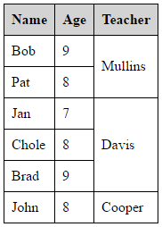
Spanning
Cell spans 2 rows
<tbody>
<tr>
<td>Bob</td> <td>9</td> <td rowspan="2">Mullins</td>
</tr>
<tr>
<td>Pat</td> <td>8</td>
</tr>
<tr>
<td>Jan</td> <td>7</td> <td rowspan="3">Davis</td>
</tr>
<tr>
<td>Chole</td> <td>8</td>
</tr>
<tr>
<td>Brad</td> <td>9</td>
</tr>
<tr>
<td>John</td> <td>8</td> <td>Cooper</td>
</tr>
</tbody>

Slide 18
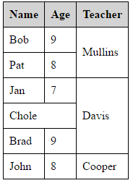
Spanning
<tbody>
<tr>
<td>Bob</td> <td>9</td> <td rowspan="2">Mullins</td>
</tr>
<tr>
<td>Pat</td> <td>8</td>
</tr>
<tr>
<td>Jan</td> <td>7</td> <td rowspan="3">Davis</td>
</tr>
<tr>
<td colspan="2">Chole</td>
</tr>
<tr>
<td>Brad</td> <td>9</td>
</tr>
<tr>
<td>John</td> <td>8</td> <td>Cooper</td>
</tr>
</tbody>
Cell spans 2 columns

Slide 19
Do NOT Use Tables for Layout
<table> is for tabullar data.
Screen readers can present the rows and columns to the visually impaired.
Browser can present header, nav, etc. in special ways.
The Twitter “Bootstrap” library provides a grid layout that lets you simulate a <table> for layout.
colspan=“8”
HEADER
colspan=“8”
NAV
colspan=“4”
SIDE
MAIN
SIDE
rowspan=“4”
colspan=“8”
FOOTER

Slide 20
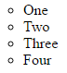
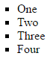
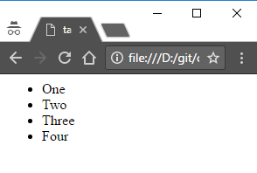
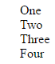
List Style
<ul>
<li>One</li>
<li>Two</li>
<li>Three</li>
<li>Four</li>
</ul>
li {
list-style: circle;
}
li {
list-style: disc;
}
li {
list-style: square;
}
li {
list-style: none;
}

Slide 21
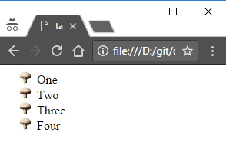
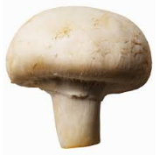
Custom List Image
li {
list-style-image: url(mush.jpg);
}
16x16

Slide 22
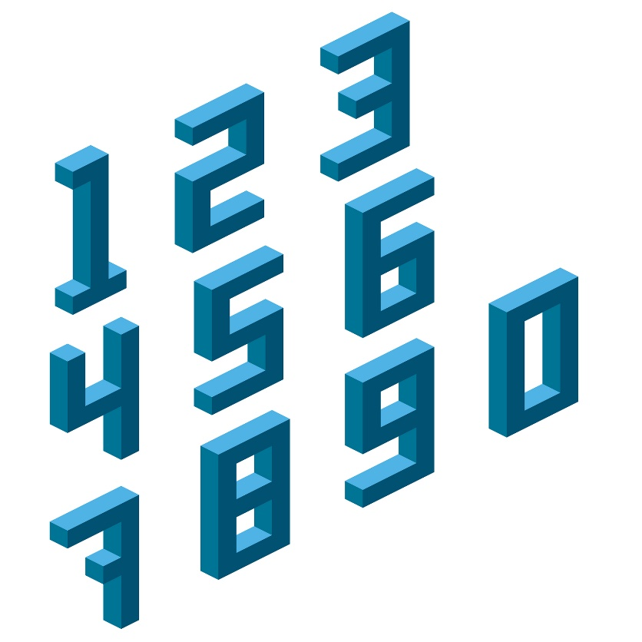
Tinkering
Create a 6x6 table of numbers with values from 1 to 36.
Change the HTML so that the middle 4 cells are a single 2x2 cell.
Add an unorder list below the table listing all the prime numbers used.
Experiment with the list-type icons.

